Slide 1

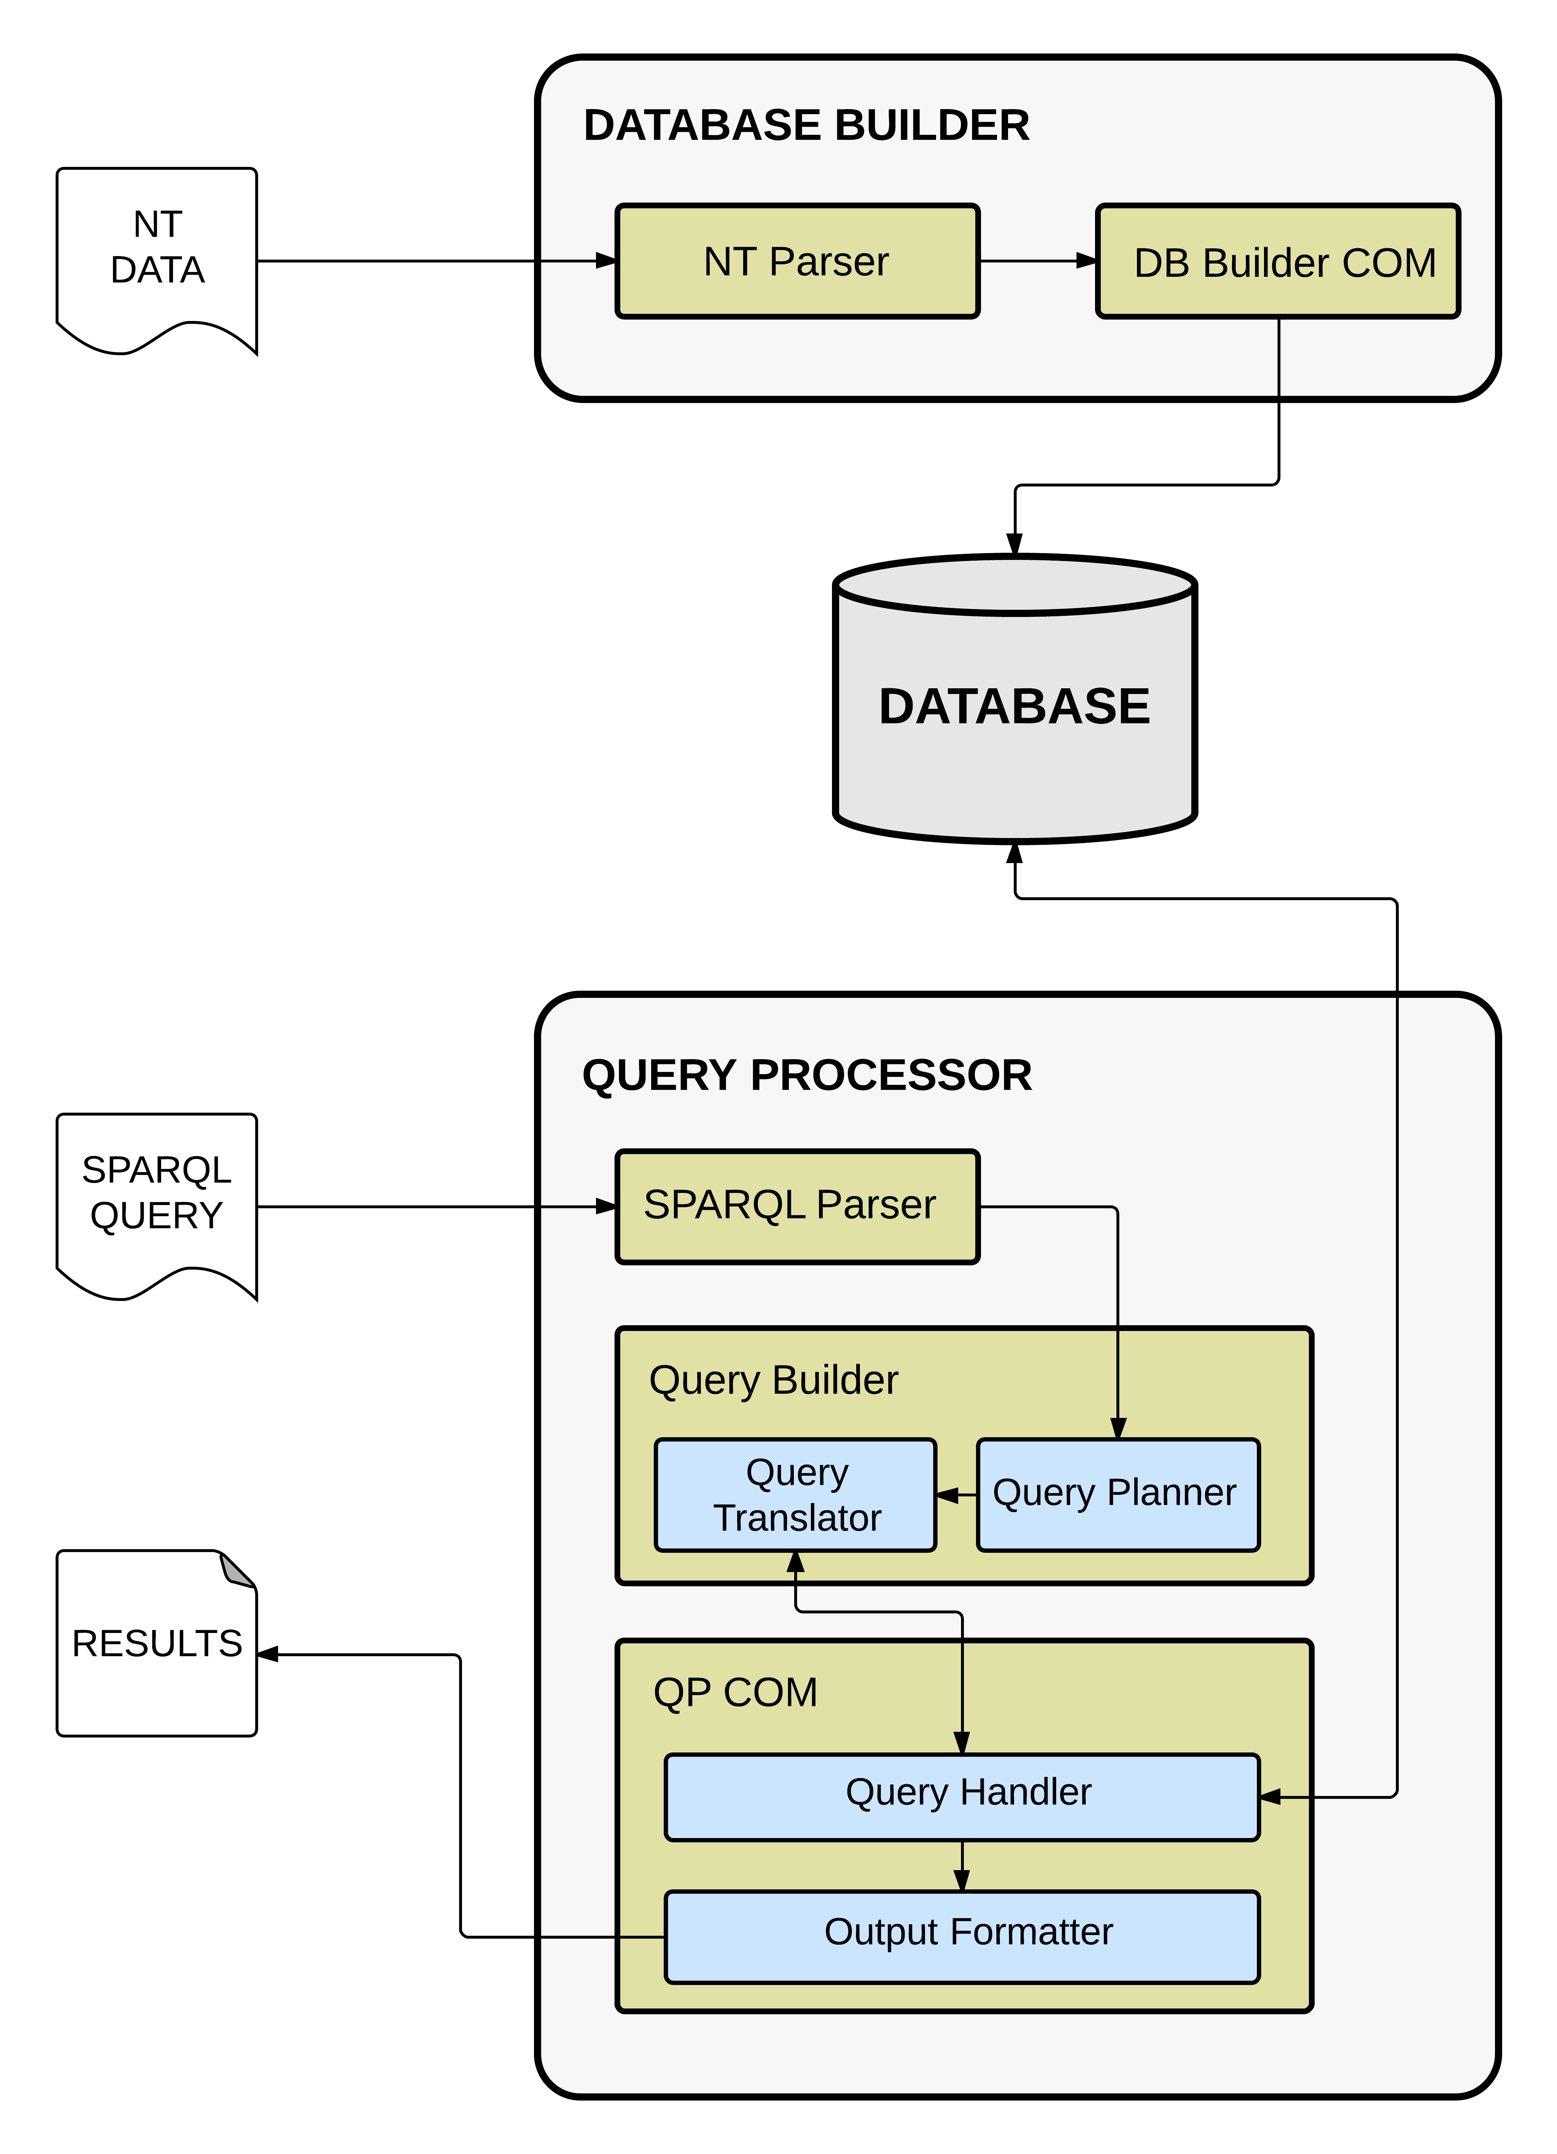
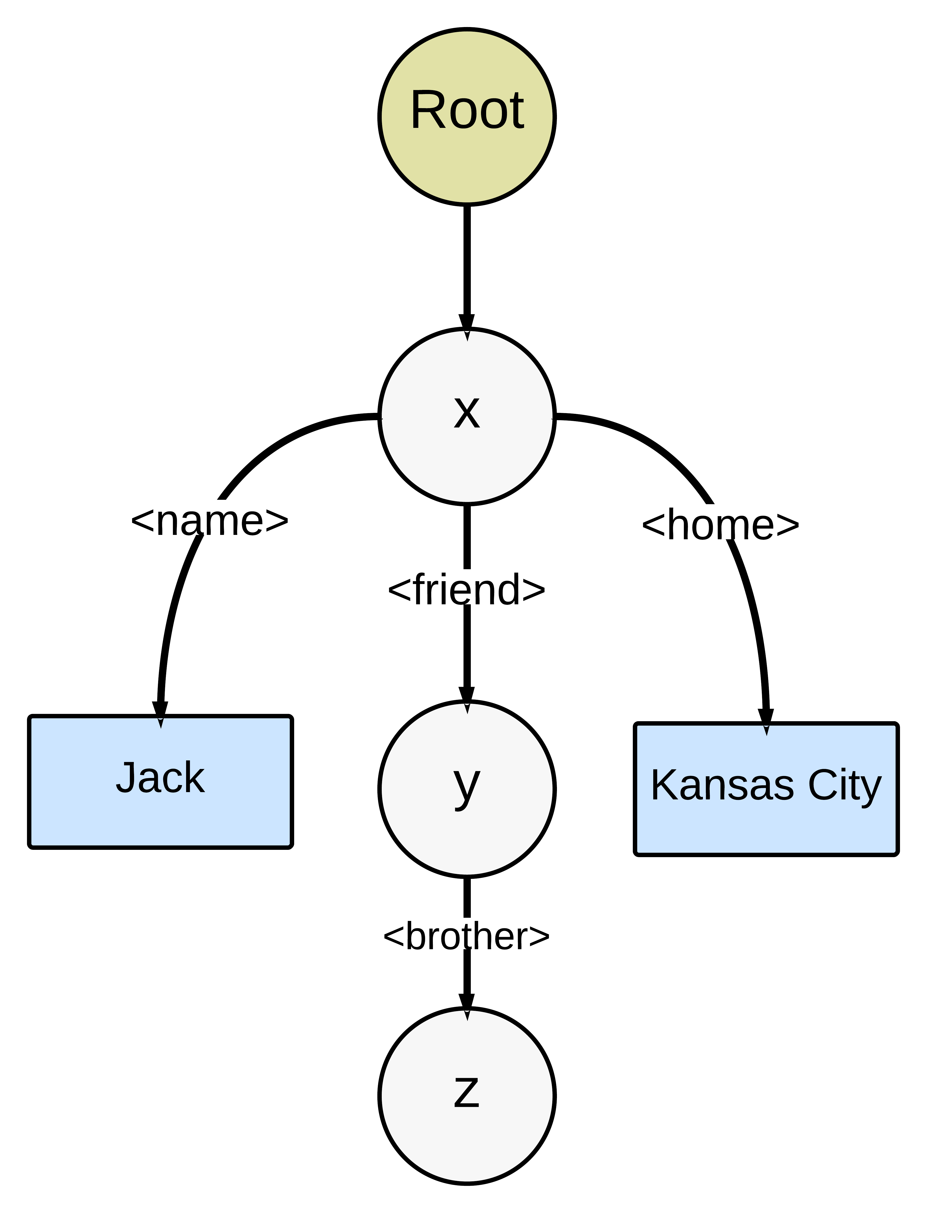
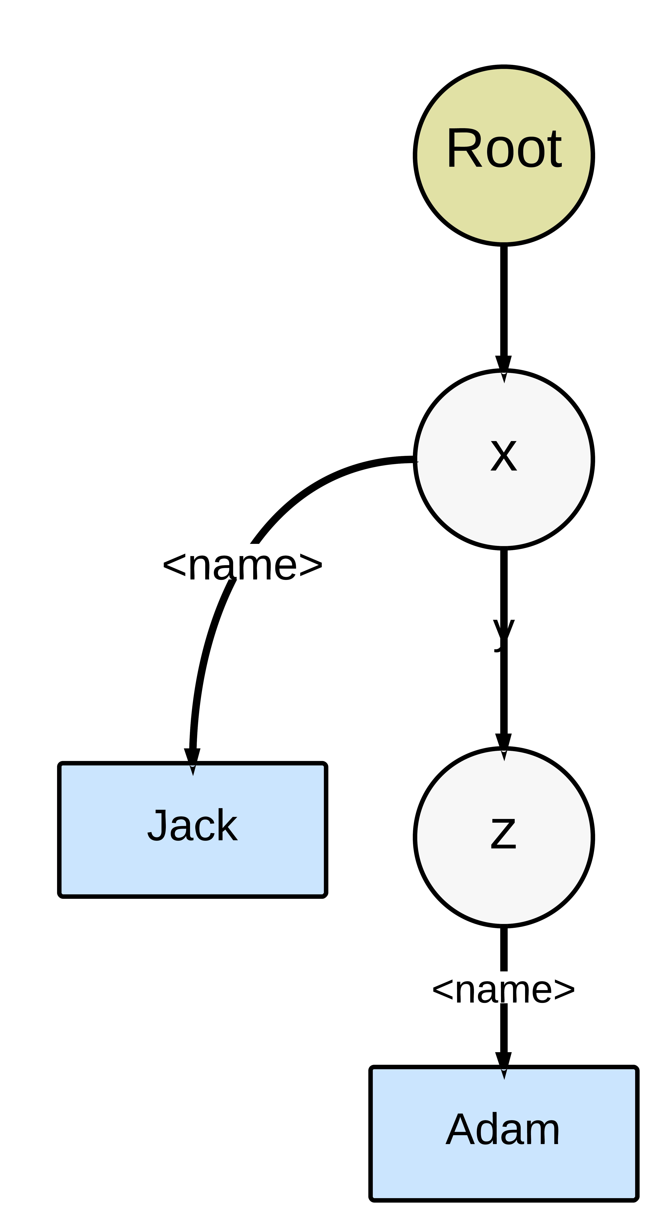
An Approach for RDF Reconstruction and Query Processing
Anas Katib, Imrul Siddique, Suresh Yarra, Prudhvi Raj Atluri Dr. Praveen Rao
Introduction
IMPLEMENTATION
Implementation
Evaluation
Motivation
Ever growing volume of data indicates we need better approaches to handle data.
Contemporary RDMS fail to scale with gigantic volume of data.
Distributive processing isn't seamless in RDMS.
New data storage model are being proposed beside RDMS; example: RDF, JSON, XML.
RDF is flexible with data-type/schema, allowing heterogeneous data to be encoded efficiently.
Challenges
Finding the right data-model as well as implementation provider
RDF is a viable option to store large data as it is flexible with large scale data.
However there is no single best answer of how we should store and query RDF.
Several proposed approaches are :
Use RDMS, i.e. encode RDF into relational tables and query;
Devise new schema to store and query RDF (referred as native stores, e.g. Jena, RDF-3X)
Use No-SQL data-store (e.g. MongoDB, Hbase, Cassandra, Neo4G etc.)
Goal
Model RDF storage and querying with MongoDB (No-SQL provider)
Compare the performance with benchmark tools (e.g. Jena, RDF-3X etc.)
Database Builder: As mentioned in the Design each RDF triple stored as document in the MongoDB.
We have written a Java program which takes the RDF N-Triple file as input and generates the MongoDB documents and stores it into the configured database:
Query Processing:
We used Apache Jena ARQ to retrieve the output variables and triple patterns and forwards them to Query Planner.
The task of Query Planner is to generate the Data Guide(DG) Graph.
The query processor will traverse it, as an edge is being traversed its corresponding vertex-to-vertex relationship will be translated into MongoDB.
Query processor execute the next relationship, which have 3 possible outcomes.
no match; then delete the row form the dMat.
exactly one match; then if the relationship contains a new variable insert a new column for that variable and insert its value in the current row, but do not create a column if there was no new variable.
1 < x matches; then replicate the row x-1 times and if the relationship contains a new variable insert a new column for the variable and insert its value in the current row and in the replicated rows, but do not create a column if there was no new variable.
Once all the edges have been processed by the query processor it returns the output variables.
QID | SPARQL QUERY | Results
1 | select ?a where { <http://uniprot.org/citations/7934828> <http://uniprot.org/author> ?a . } | 17
2 | select ?p ?o where { <http://purl.uniprot.org/uniprot/Q6GZX4> ?p ?o . } | 29
4 | select ?x ?z where { ?x <http://purl.uniprot.org/core/name> ?y . ?x <http://purl.uniprot.org/core/volume> ?z . ?x <http://purl.uniprot.org/core/pages> "176-186" . } | 1
6 | select ?x ?y where { ?x ?y "Israni S." . <http://purl.uniprot.org/citations/15372022> ?y "Gomez M." . } | 48
8 | select ?x ?z ?a where { ?x <http://purl.uniprot.org/core/reviewed> ?y . ?x <http://purl.uniprot.org/core/created> ?b . ?x <http://purl.uniprot.org/core/mnemonic> "003L_IIV3" . ?x <http://purl.uniprot.org/core/citation> ?z . ?z <http://purl.uniprot.org/core/author> ?a . } | 8
RDF | mongoDB
<sub1> <prop1> <obj1>. | { subject: <sub1>, property: <prop1>, object: <obj1> }
<sub1> <prop2> “val”. | { subject: <sub1>, property: <prop2>, object: “val” }
<sub2> <prop1> <obj1>. | { subject: <sub2>, property: <prop1>, object: <obj1> }
MongoClient mc=new MongoClient(Arrays.asList(new ServerAddress("localhost", 27017))); DB db=mc.getDB("suresh"); Set<String> sc=db.getCollectionNames(); DBCollection c=db.getCollection("col"); BasicDBObject bob=new BasicDBObject("subject", q[0]) .append( "property", q[1]).append("object", s); c.insert(bob);
QID | SPARQL QUERY | Results
3 | select ?x ?y where { ?x <http://purl.uniprot.org/core/name> "Virology" . ?x <http://purl.uniprot.org/core/volume> ?y . } | 25
5 | select ?x ?y ?z where { ?x <http://purl.uniprot.org/core/name> "Science" . ?x <http://purl.uniprot.org/core/author> ?y . ?z <http://purl.uniprot.org/core/citation> ?x . } | 53013
7 | select ?a ?b where { ?x ?y <http://purl.uniprot.org/citations/15165820> . ?a ?b ?y . } | 574692
DEsign
Two main components
Database builder
responsible for converting RDF data into MongoDB documents.
Each RDF triple is stored as an independent document in MongoDB, because MongoDB will return the documents matched a query.
Query Processor
responsible for converting SPARQL queries into MongoDB queries and returning results.
We proposed a Data Guide(DG) graph, to find the optimal order such that triples that are independent should be processed beforehand.
Software | Ave. Data Loading and Indexing Time
Jena | 10.5 seconds
mongoDB | 145 seconds
SELECT ?x ?y ?z WHERE { ?x <name> “Jack”. ?x <friend> ?y. ?y <brother> ?z. ?x <home> “Kansas City”. } | SELECT ?x ?y ?z WHERE { ?x ?y ?z. ?x <name> “Jack”. ?z <name> “Adam”. }
Evaluation setup
References
Metric | Measurement
Number of input triples | 831,696
Input file size | 109 MB
Database size | 1.5 GB
RAM Limit | 1 GB
Number of runs | 2 per software
Number of queries | 8
Bornea, Mihaela A., et al. "Building an Efficient RDF Store Over a Relational Database".2013. 121-132. Print.
Apache Jena. The Apache Software Foundation, Web. 01 May 2014. <https://jena.apache.org/index.html>.
Weiss, Mark A. Florida International University. School of Computing and Information Sciences, Web. <http://users.cis.fiu.edu/~weiss/dsj2/code/Graph.java>.
"Map-Reduce." MongoDB. MongoDB, Inc., Web. 21 Feb. 2014. <http://docs.mongodb.org/manual/core/map-reduce/>.

